Slide 1

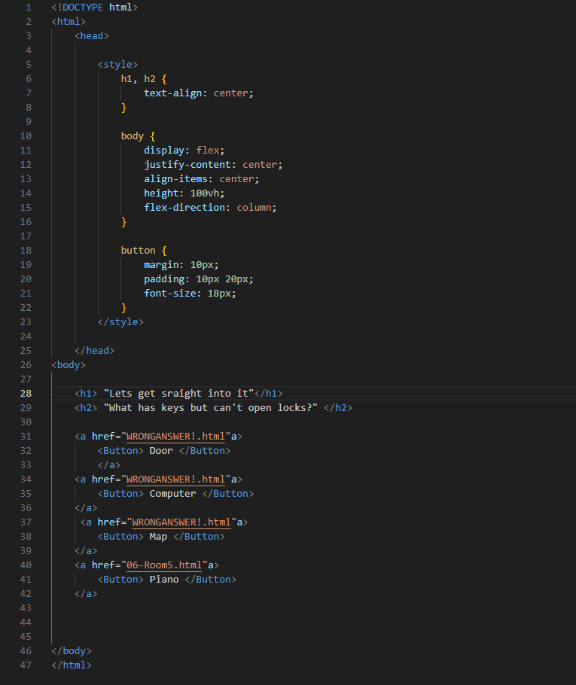
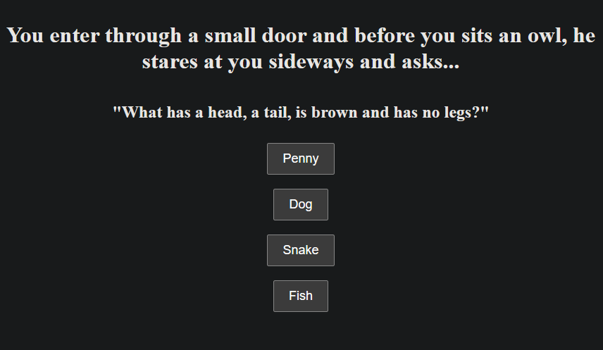
My SPA – A text-based riddle game
The basic coding for my game
Uses a basic Hyperlink System
Changes between the next room if guessed correctly
Back to the start if incorrect
Finishes the Game if you get to the end
The riddle Screen
A brief description of the room and an owl speaking to you
4 answers, 3 wrong, 1 correct
Correct answer takes you to the next room
Wrong answer take you back to the start

